Slide 1
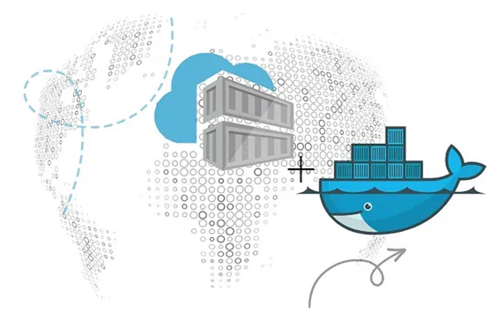
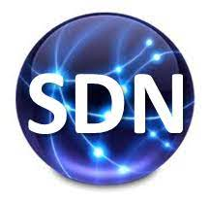
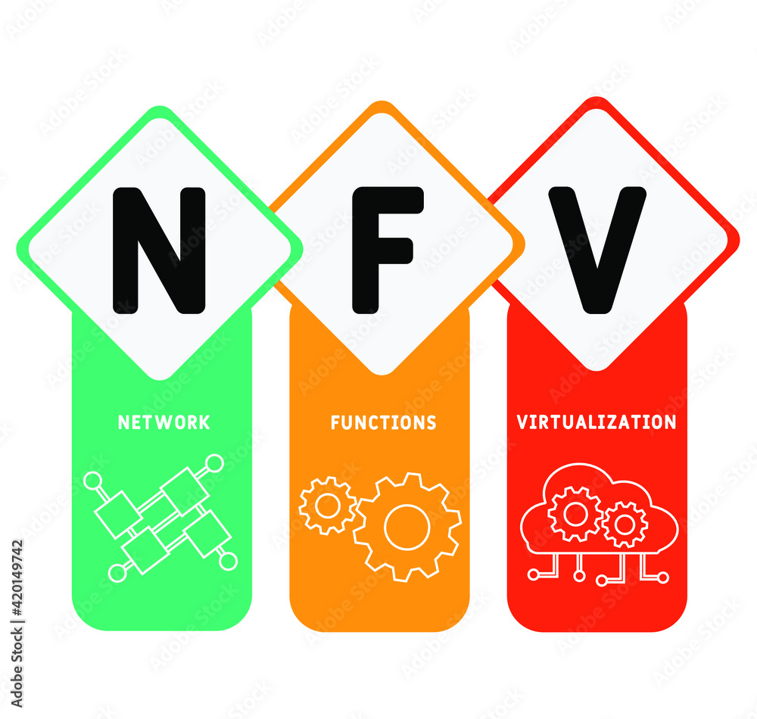
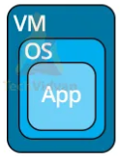
PDS
Computer Vision
Managing Infrastructure as Code (IaC) with
Open TofU-IaC
Terraform
https://github.com/siagianp
https://www.youtube.com/@AmelOline/videos
https://github.com/amelcharolinesgn2/IoT_simulator-mqtt-NodeRed
https://github.com/amelcharolinesgn2/Cloud-Infrastructures
Notes:
https://roadmap.sh/aws
https://roadmap.sh/aws
https://aws.amazon.com/what-is-cloud-computing/
https://www.ibm.com/think/topics/cloud-computing
3. https://www.ibm.com/topics/cloud-computing
4. https://csrc.nist.gov/pubs/sp/800/145/final
https://csrc.nist.gov/pubs/sp/800/145/final
https://docs.openstack.org/liberty/install-guide-rdo/overview.html

Slide 2
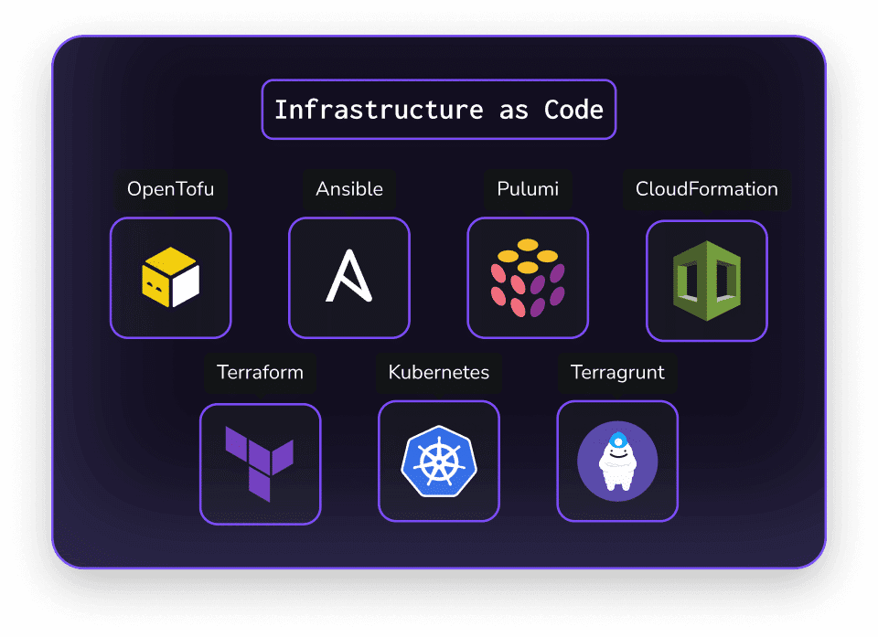
Infrastructure as Code tools
Notes:
https://spacelift.io/how-it-works

Slide 3
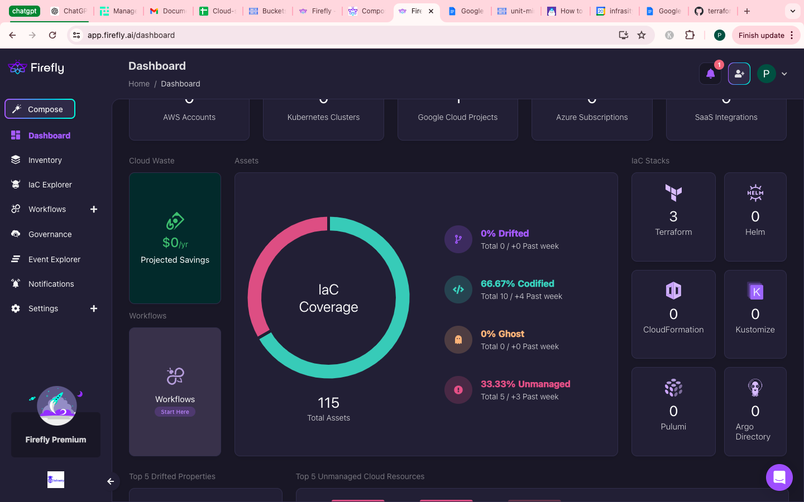
Dasboard

Slide 4
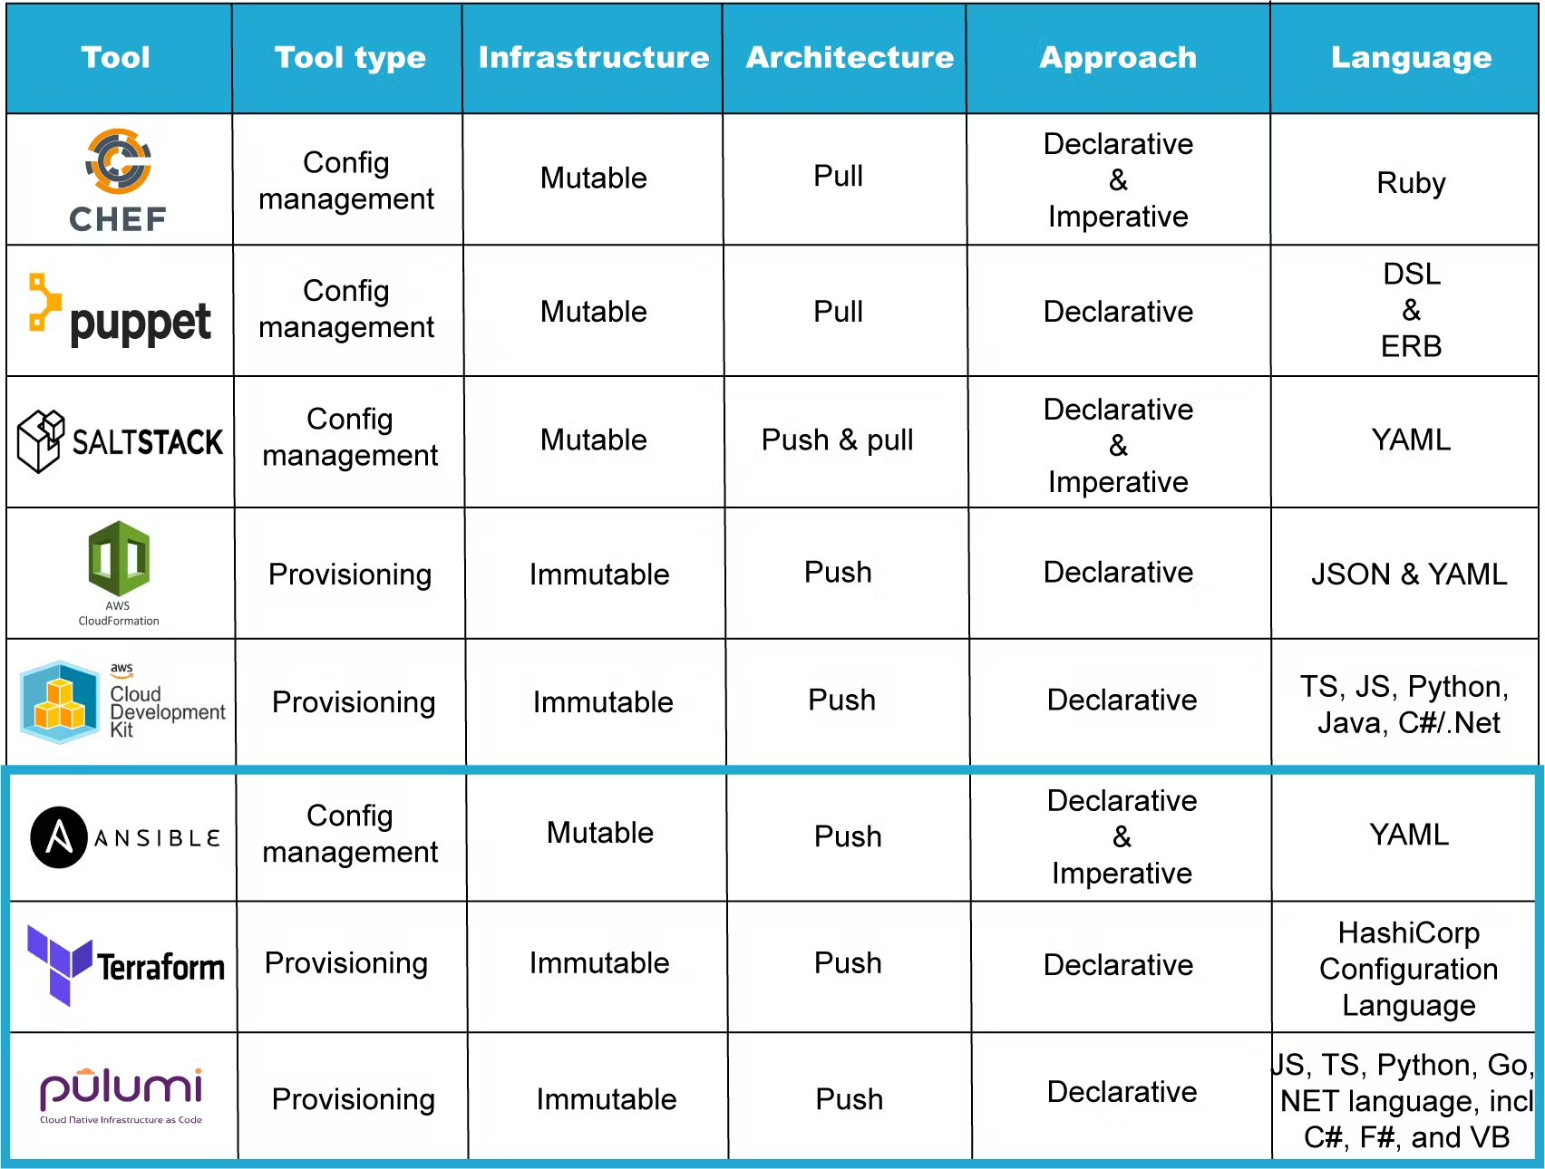
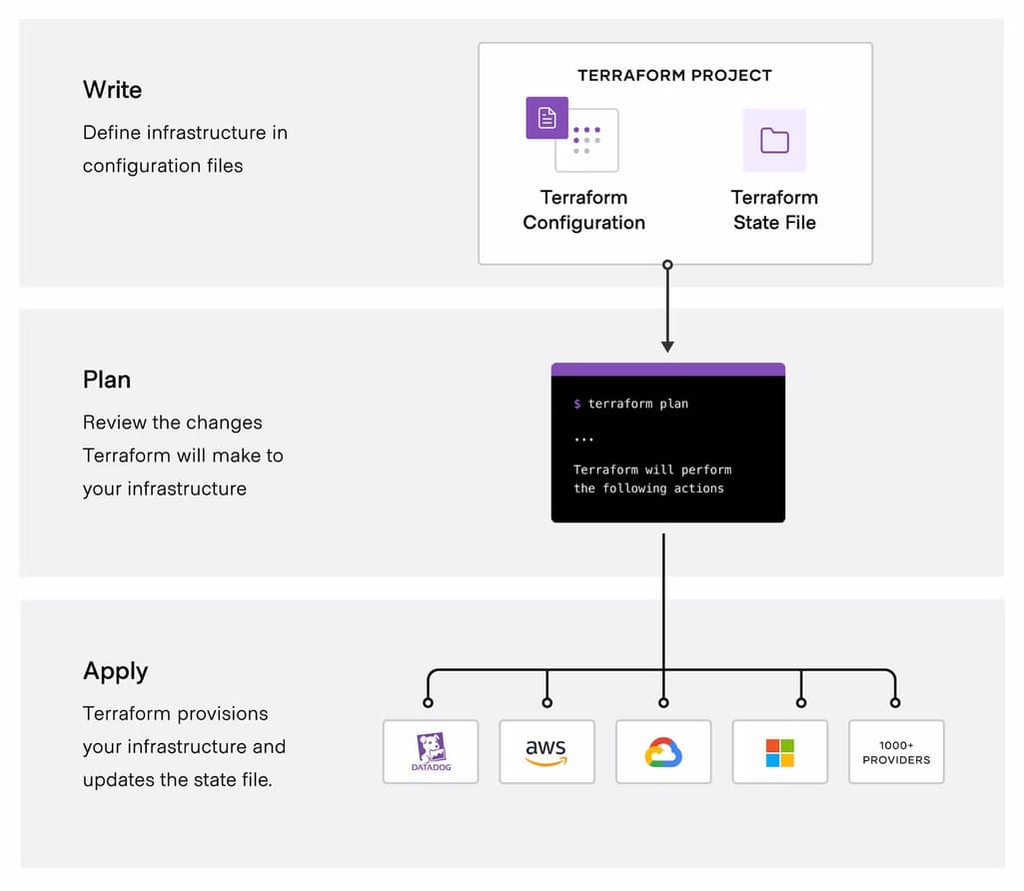
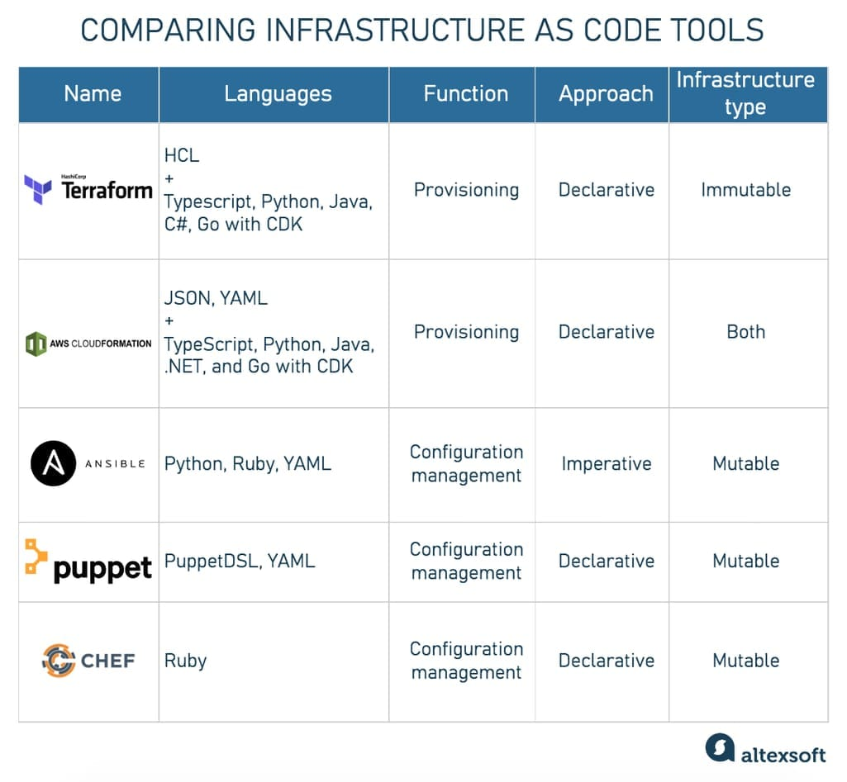
Comparing Infrastructure as Code tools
The question of IaC in DevOps, main terms in simple words;
Infrastructure as Code benefits;
Best practices and Infrastructure as Code implementation tips;
Overview of the Infrastructure as Code tools;
Prognosis for industry.
Notes:
https://alpacked.io/blog/infrastructure-as-code-for-devops/
https://www.altexsoft.com/blog/infrastructure-as-code/

Slide 5
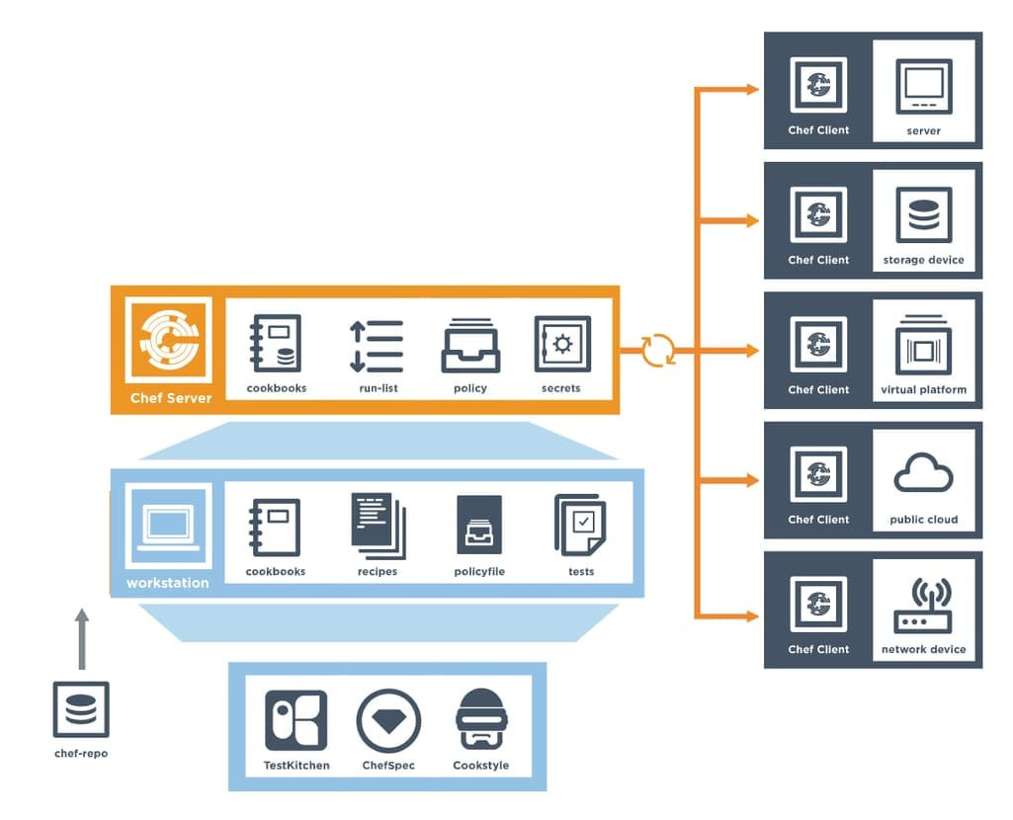
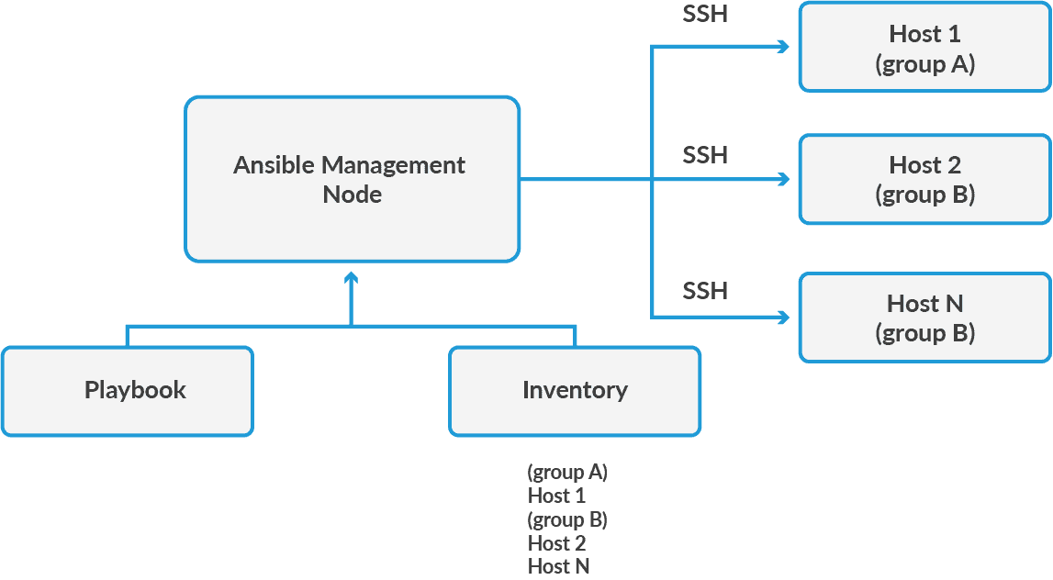
Ansible – configuration
The map of Chef components
Notes:
https://www.altexsoft.com/blog/infrastructure-as-code/

Slide 6
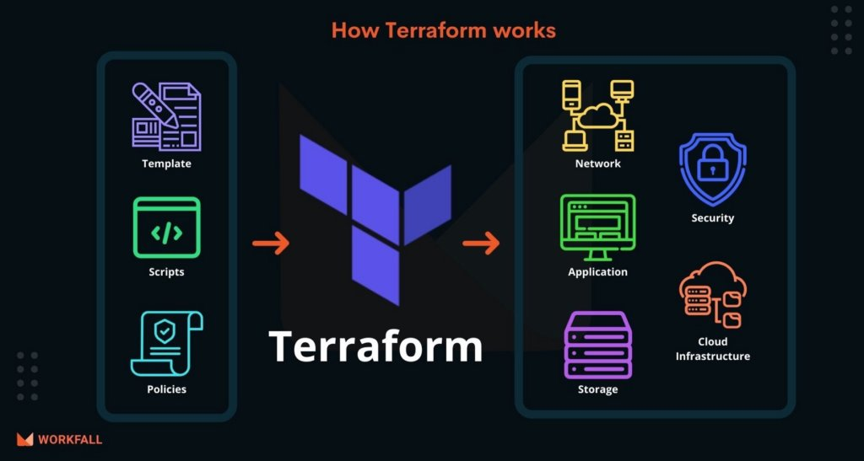
IaC-Terraform
Notes:
https://docs.openstack.org/liberty/install-guide-rdo/overview.html

Slide 7
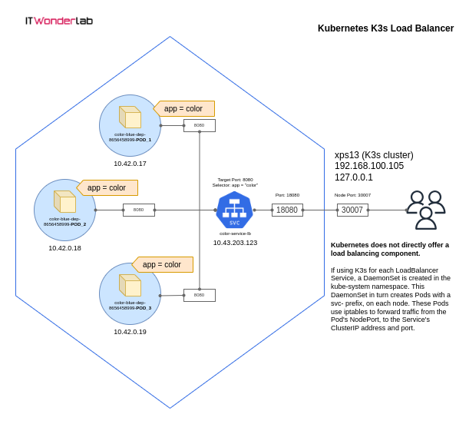
Deploy Applications in Kubernetes using Open TofU-IaC
Notes:
https://www.itwonderlab.com/kubernetes-with-opentofu/

Slide 8
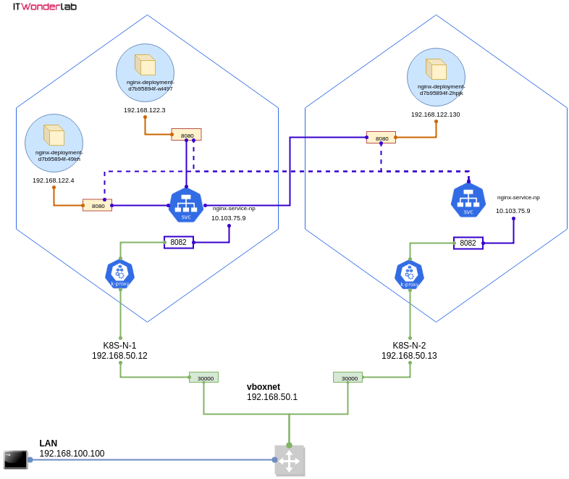
Deploy Applications in Kubernetes using Open Terraform
Notes:
https://www.itwonderlab.com/kubernetes-with-terraform/

Slide 9
Thx

